Slide 1
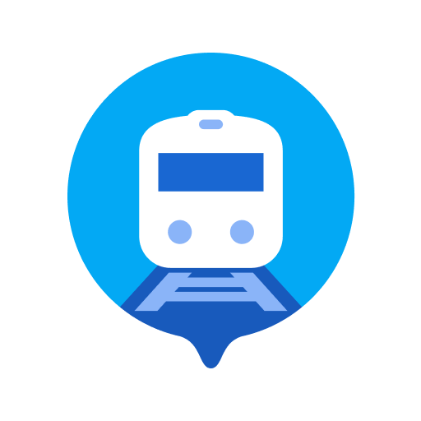


TRAINTRACKER
TIMOTHY OLIVER & TREVOR KAPUVARI

Slide 2

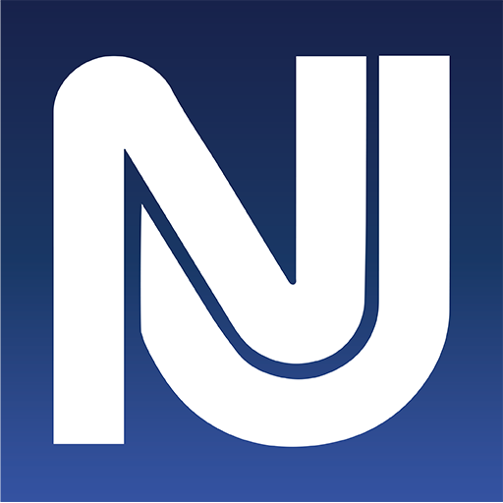
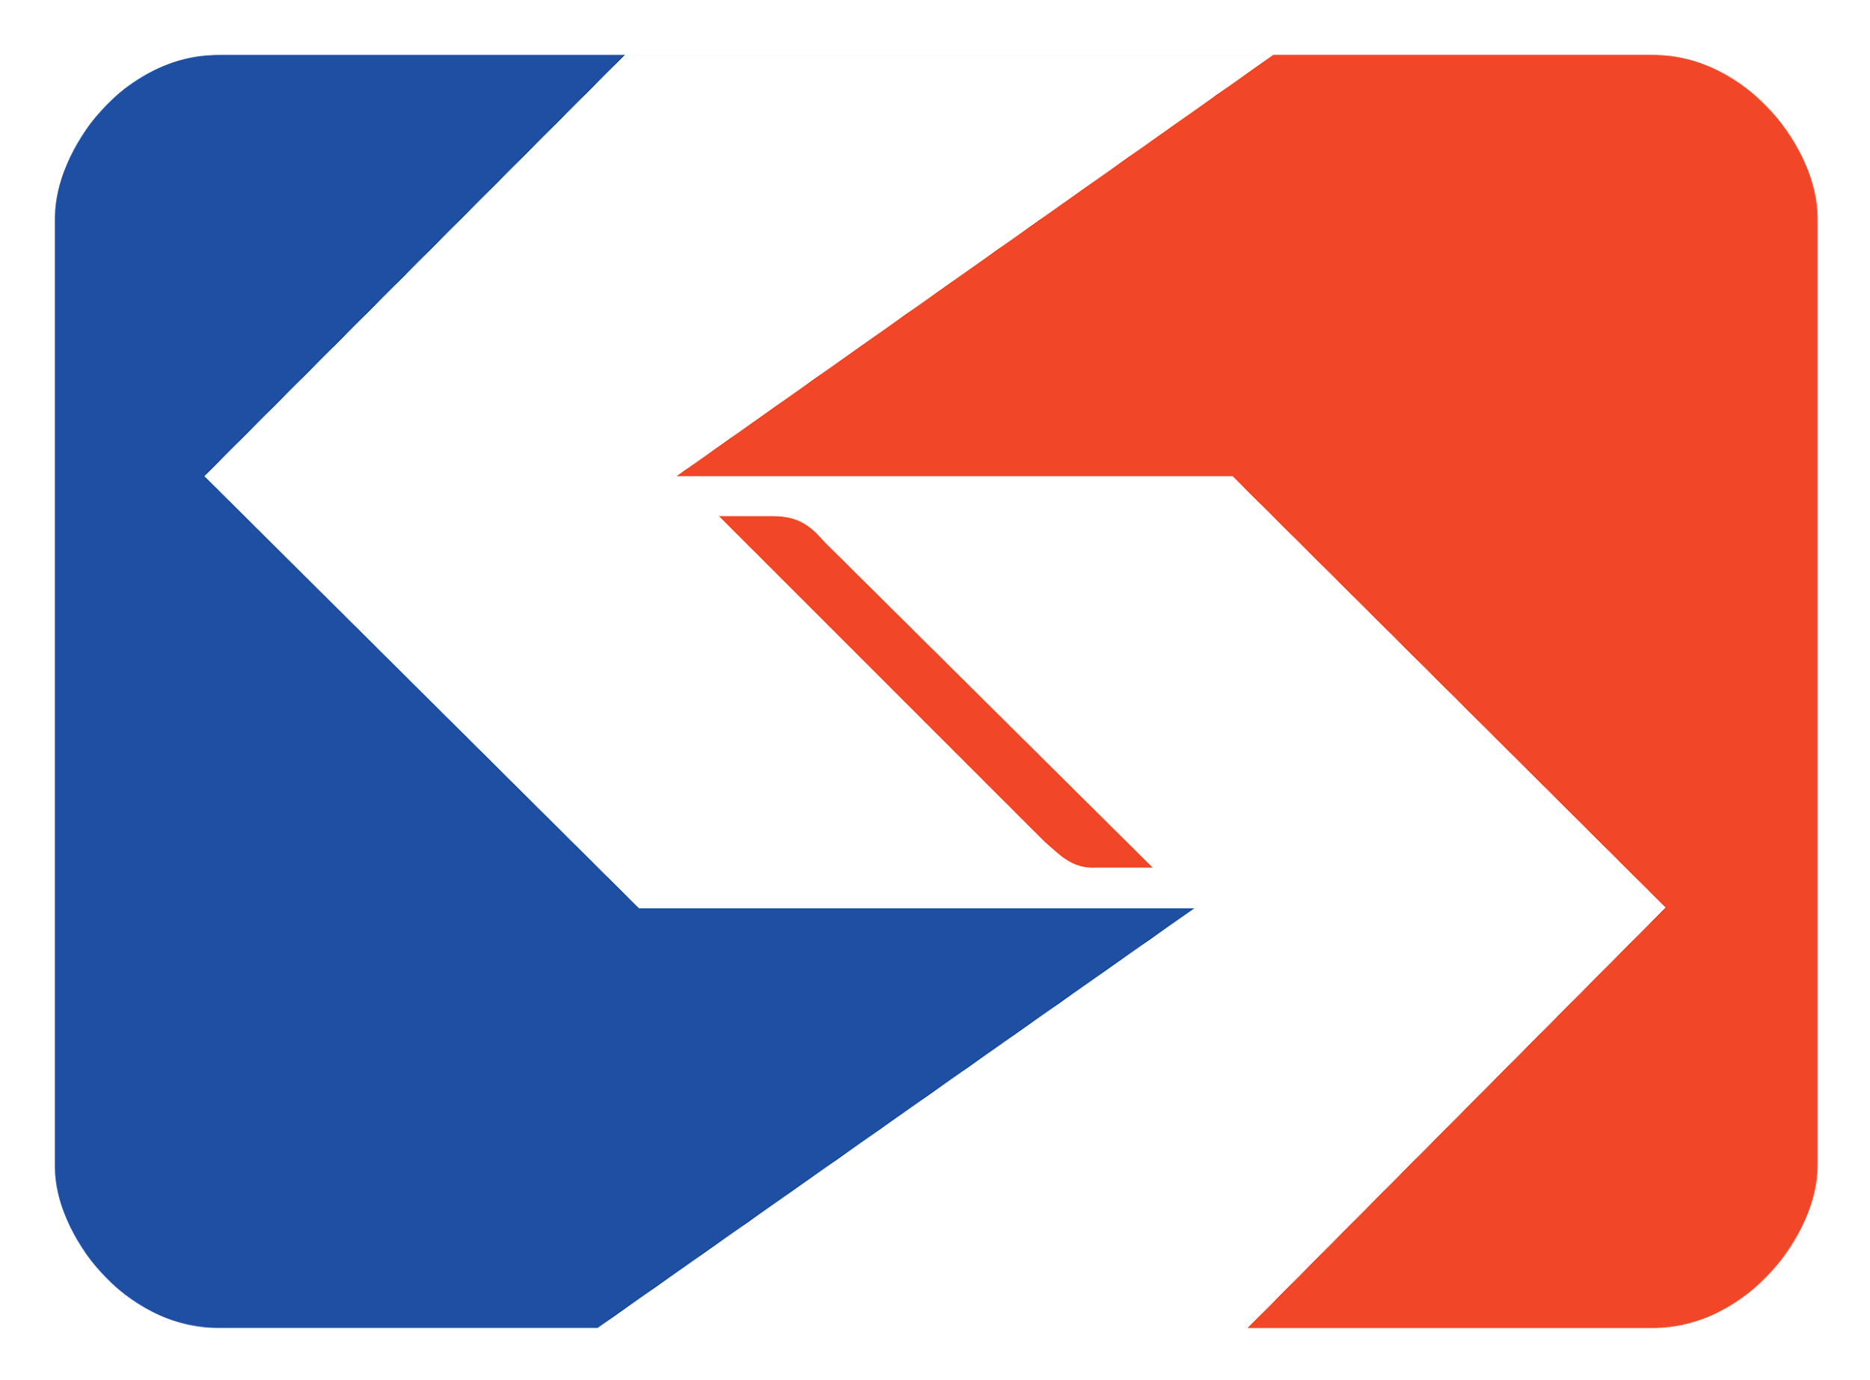


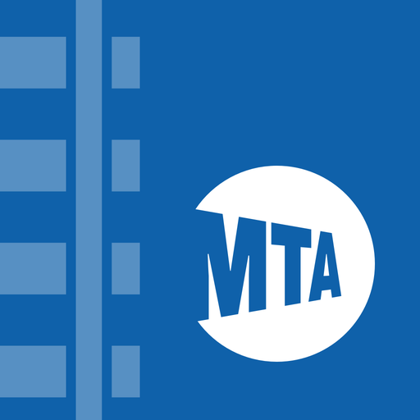

PURPOSE AND USE
Coalesce multiple apps
Convenient for riders
Inter-state travelers
Purchase, plan, and informed
For riders in the Northeast

Slide 3
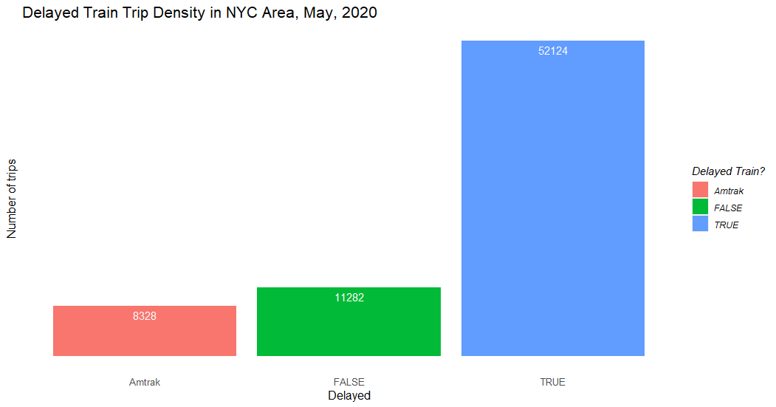

A WORLD OF DELAYS
70% of recorded trains delayed
Some more than others
Find which ones matter most

Slide 4
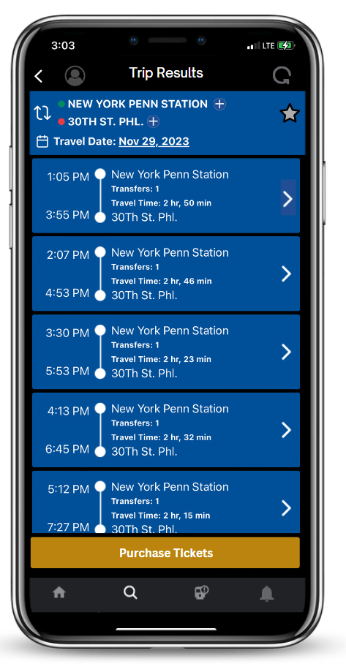
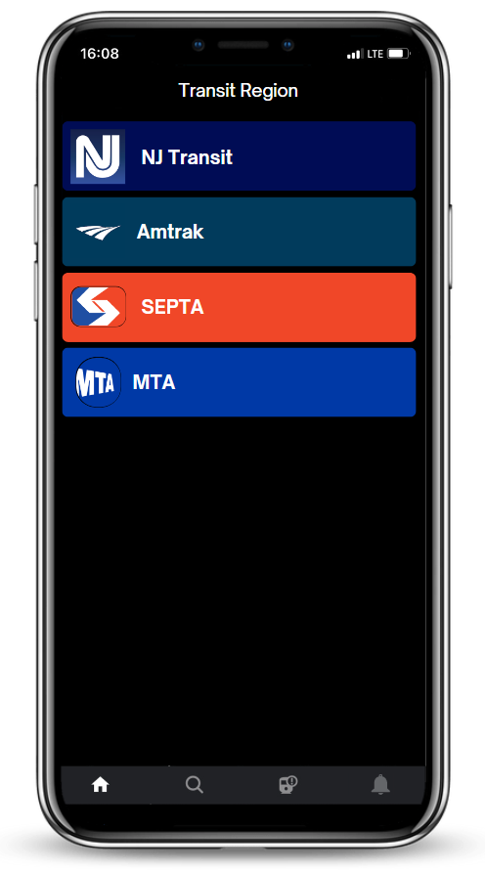
ONE-WAY STOP
Train information across 4 organizations
Predicts train delays
Provides ratings on train line performances on daily basis
All in one
4

Slide 5
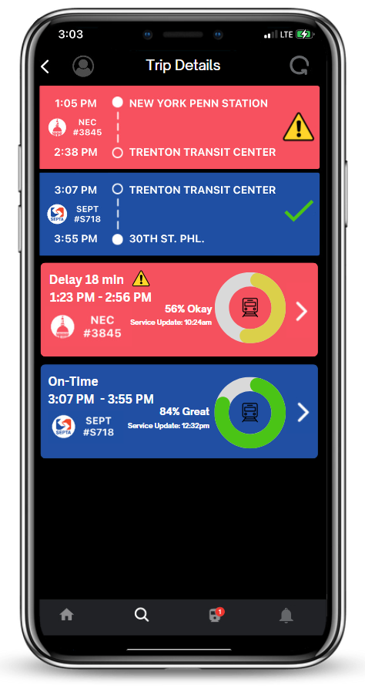
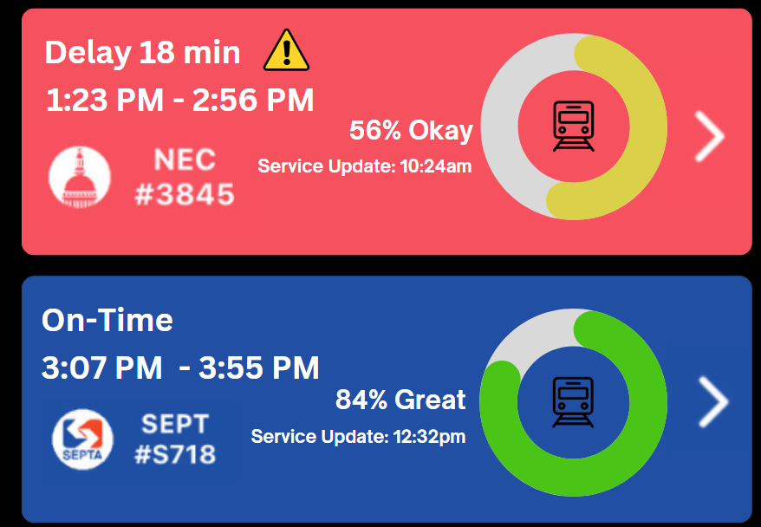
INFORMING AFTER PURCHASE
Indicate delays
Rating of train’s performance
5

Slide 6
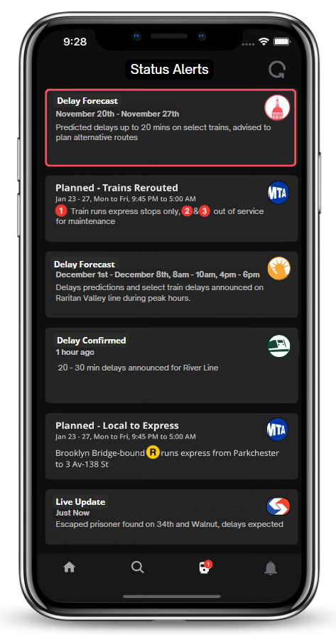
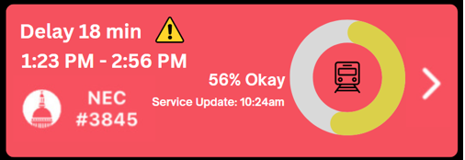

DISPLAYING DELAYS
Updates about purchases at top
Algorithm consisting of two models
Length of delay
Probability of delay
6

Slide 7
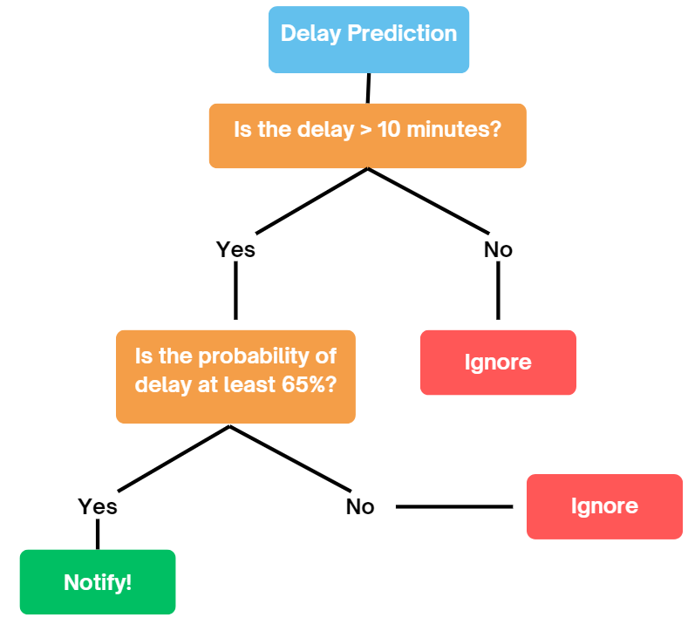


Slide 8
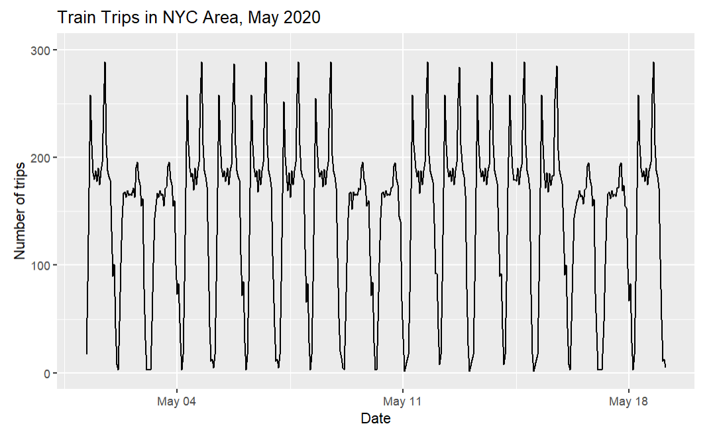

WHEN TO PREDICT
Predictions calculate 24 & 12 hours in-advance
Informs user after purchase
Becomes general status alert if cyclical/non-outlier

Slide 9
IN-APP LIVE FEED
Status alerts for complete list of train updates
Highlights relevant alerts for purchased tickets
Transit authority live-feed is crucial for
Cancellations
Reroutes
Live Updates

Slide 10
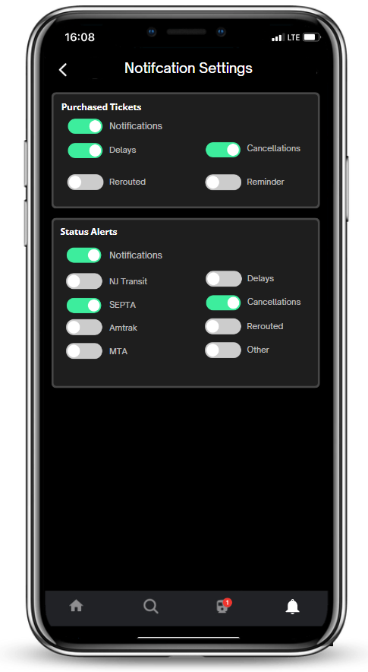
NOTIFICATIONS
Riders/Users choose what they are notified with outside app
Reminder setting has 20, 10, & 5-minute intervals
Delays are notified > 10 minutes

Slide 11
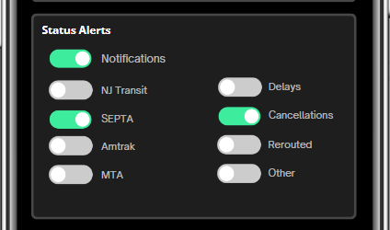

FILTERING INFORMATION
Filtering alerts
Not notified outside app
Purchased tickets included in alerts

Slide 12

FEASIBILITY & NEXT STEPS
Requires efforts of all transit authorities for real-time updates on train information
Access to ticket purchasing (if possible)
Provide similar metrics from pre-existing apps (CityMapper & Transit)
Primarily for riders
Train authorities can use app for recording their performance

Slide 13

THANK YOU!

